Slide 1

Session 2
Linear Programming – Transportation
Big Data and Analytics
Topic 2:
Data Sourcing and Ingestion
We will wait for 5 to 10 mins for everyone to join

Slide 2
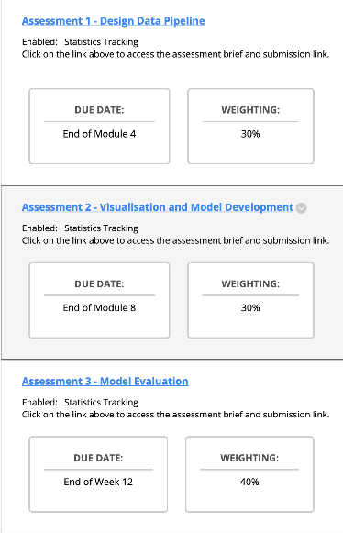

A message to new students
Linear Programming – Transportation
In this subject we use the following software:
Anaconda
Jupyter
Python
MongoDB
Spark

Slide 3

Recap
Linear Programming – Transportation
What we discussed last week?

Slide 4

Recap
Linear Programming – Transportation
What we discussed last week?
Data is generating every day
The rapid growth of data
120 zettabytes generated in 2023.
It is expected to increase by over 150% in 2025.
Hitting 181 zettabytes

Slide 5
Recap
Linear Programming – Transportation
What we discussed last week?
Data is generating every day
The rapid growth of data
MB
GB
Tera Byte
Peta Byte
Exa Byte
Zetta Byte : one zettabyte is equal to a
trillion gigabytes
Yotta Byte
120 zettabytes generated in 2023.
It is expected to increase by over 150% in 2025.
Hitting 181 zettabytes

Slide 6
Recap
Linear Programming – Transportation
Big Data Characteristics

Slide 7
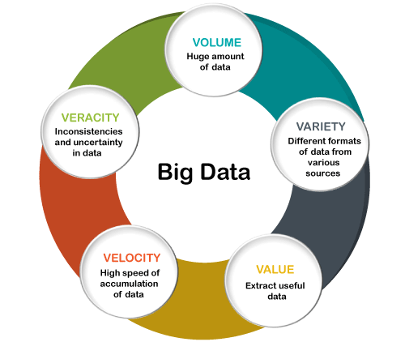
Recap
Linear Programming – Transportation
Big Data Characteristics

Slide 8
Recap
Linear Programming – Transportation
Data Life Cycle

Slide 9
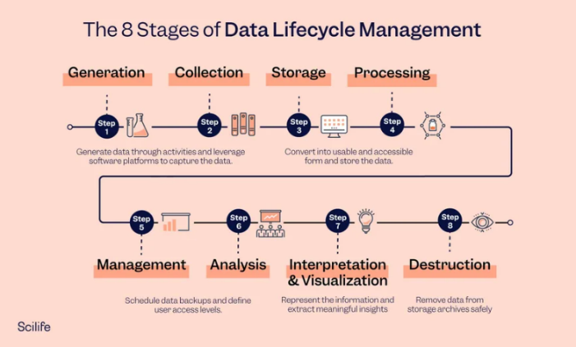
Recap
Linear Programming – Transportation
Data Life Cycle
Data Generation
Data Ingestion
Data Storage
Data Processing
Data Analysis
Data Visualisation
Decision-Making
Data Maintenance
Scaling and Optimisation
Feedback Loop
Notes:
Data Generation: Data is created from various sources.
Data Ingestion: Data is collected and prepared for storage.
Data Storage: Data is stored in scalable systems.
Data Processing: Data is processed for analysis.
Data Analysis: Insights are derived from the data.
Data Visualization: Data is presented visually for understanding.
Decision-Making: Informed decisions are made.
Data Maintenance: Data is updated and maintained.
Scaling and Optimization: Infrastructure is optimized as data grows.
Feedback Loop: Insights drive changes and improvements.

Slide 10
Module 2: Data Sourcing and Ingestion
Linear Programming – Transportation
Module 2 Lecture Covers:
Different sources of data;
The varying structures of data;
The ‘data lake’ concept and its importance in a data-driven organisation;
MongoDB
Module 2 Workshop Covers:
Install the MongoDB Database
Creating documents and a collection

Slide 11
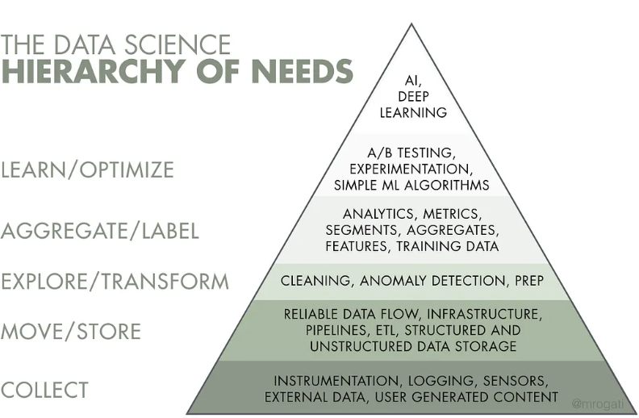
Module 2: Data Sourcing and Ingestion
Linear Programming – Transportation
Data Science—Hierarchy of Needs
Notes:
This pyramid highlights the relative importance of building an effective data pipeline enabling efficient data flow, integration, storage and retrieval. Once an organisation makes a strategic decision to develop data intelligent products, the first step is to build the infrastructure to source, collect and store the relevant data,
Artificial intelligence (AI) and machine learning (ML) algorithms sit at the top two levels of the pyramid.
Data can be collected from an external source or internal source. The structure of data coming from different sources can vary significantly.
An effective data pipeline needs to consider both the source and structure of the data.
Additionally, the data pipeline needs to address the ‘V’ characteristics of big data.

Slide 12
Module 2: Data Sourcing and Ingestion
Linear Programming – Transportation
What is Data?
Data is a collection of facts, figures, and statistics that can be used for analysis.
The accuracy and quality of decision-making processes often rely on the source of data.
Types of Data
Primary Data: Collected first-hand for a specific purpose.
Examples: Surveys, Interviews, Experiments
Advantages: Specific to your purpose, up-to-date, reliable.
Disadvantages: Time-consuming, often more expensive.
Secondary Data: Data collected by someone else, for another purpose.
Examples: Census data, archived research, databases.
Advantages: Easily accessible, cost-effective.
Disadvantages: Not specific to your needs, might be outdated.

Slide 13
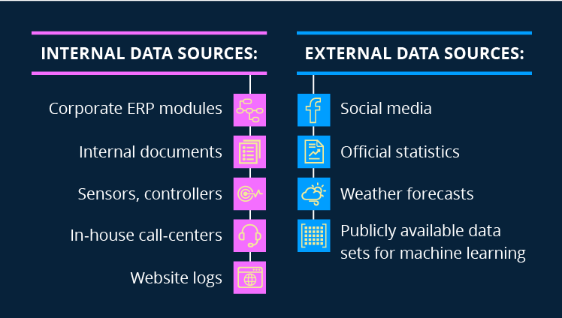
Module 2: Data Sourcing and Ingestion
Linear Programming – Transportation
Various Sources of Data
Internal Sources: Originates within the organisation or individual's domain. covering areas such as operations, maintenance, personnel, and finance.
Examples: Sales reports, feedback forms, company databases.
External Sources: Comes from outside the organisation or individual's domain.
Examples: Government reports, market research agencies, publications.

Slide 14
Module 2: Data Sourcing and Ingestion
Linear Programming – Transportation
Various Sources of Data
Internal or External?
Company's Monthly Sales Report
Government's Annual Employment Statistics
Customer Feedback Form on a New Product
Research Study Published by an Independent Market Research Firm
Inventory Records of a Retail Store
A Competitor's Marketing Strategy Obtained from Industry Conferences
Employee Satisfaction Survey Results
Data from a Publicly Available Database on Global Climate Changes
A Company’s Audit Report
Financial Data Published in a Newspaper about the Top Performing Companies
Notes:
Internal
External
Internal
External
Internal
External
Internal
External
Internal
External

Slide 15
Module 2: Data Sourcing and Ingestion
Linear Programming – Transportation
Various Sources of Data
Printed Sources: Available in physical, printed form.
Examples: Books, newspapers, magazines.
Electronic Sources: Found digitally, usually online.
Examples: Websites, online databases, e-books.
Experimental Data: Obtained through scientific or laboratory experiments.
Examples: Clinical trials, lab results.
Observational Data: Collected by observing phenomena as they occur.
Examples: Behavioural studies, CCTV footage.
Notes:
The Importance of Choosing the Right Source
Ensuring relevance to the research or business question.
Assessing the accuracy and reliability of the data.
Time and cost considerations.
5. Potential Pitfalls
Bias: Some sources may present data with a certain angle or agenda.
Inaccuracy: Not all sources maintain rigorous data accuracy standards.
Irrelevance: The source may not be applicable to your specific needs.
6. Evaluating Sources
Always consider the origin, recency, and credibility of the data source.
Check if the methodology of data collection is provided and if it's sound.
Peer-reviewed or third-party verified sources tend to be more reliable.

Slide 16
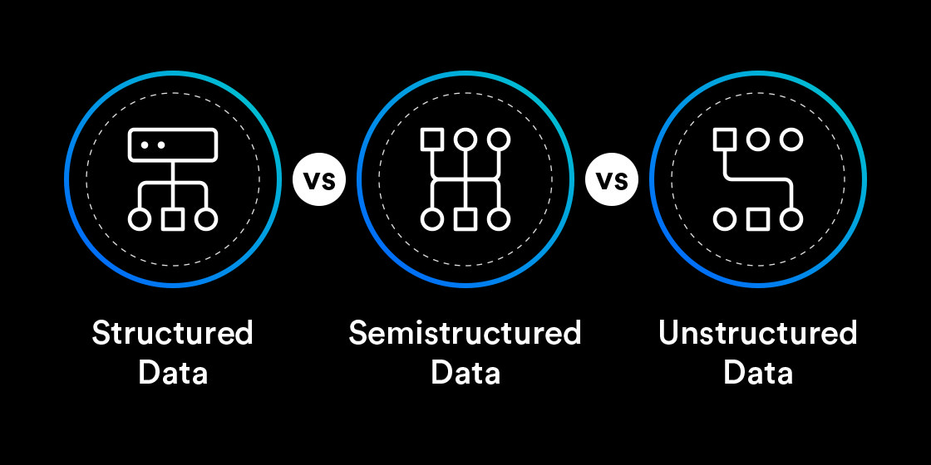
Module 2: Data Sourcing and Ingestion
Linear Programming – Transportation
The varying structures of data:
The Importance of Data Structures: Affects how we store, process, and analyse data.
Notes:
Data is everywhere, but it doesn't always come in the same format.
The way data is organised or structured affects how we store, process, and analyse it.

Slide 17

Module 2: Data Sourcing and Ingestion
Linear Programming – Transportation
The varying structures of data:
Structured Data: Data that adheres to a fixed format or schema.
Characteristics: Easily searchable. Highly organised. Defined length and format.
Examples: Relational databases (like SQL). CSV files. Excel spreadsheets.
Advantages: Efficient for querying. Easily analysed. Supports transactions.
Disadvantages: Inflexible to changes in schema. May not capture all types of data.
Notes:
structured data is typically organised in rows and columns.

Slide 18

Module 2: Data Sourcing and Ingestion
Linear Programming – Transportation
The varying structures of data:
Semi-Structured: Data that doesn't have a rigid structure but contains tags, hierarchies, or other markers to group and convey relationships between elements.
Characteristics: Contains tags, elements, and attributes. Not organised in rows and columns.
More flexible than structured data.
Examples: XML documents. JSON files. Email.
Advantages: Offers flexibility in data capture, Contains meta-data, Can be converted to structured format if necessary.
Disadvantages: Less efficient to query than structured data.
May require more storage space.

Slide 19

Module 2: Data Sourcing and Ingestion
Linear Programming – Transportation
The varying structures of data:
Unstructured: Data that doesn’t have a specific form or model.
Characteristics: No pre-defined model. Harder to analyse and query. May come from various sources.
Examples: Social media posts. Multimedia content (videos, images, audio).
Advantages: Captures data in its natural form. Flexible and varied. Represents human input and interaction well.
Disadvantages: Requires advanced tools and methods to analyse. Not easily searchable. Storage can be a challenge due to volume and variety.
Notes:
It's often text-heavy but can contain other data like images and videos.

Slide 20
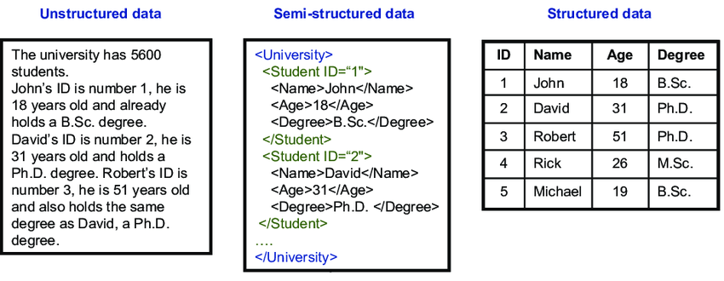
Module 2: Data Sourcing and Ingestion
Linear Programming – Transportation
The varying structures of data:
Comparing the Three:
Scale
Flexibility
Ease of Analysis
Notes:
Comparing the Three
Scale of Organization: Structured > Semi-structured > Unstructured.
Flexibility: Unstructured > Semi-structured > Structured.
Ease of Analysis: Structured > Semi-structured > Unstructured.

Slide 21
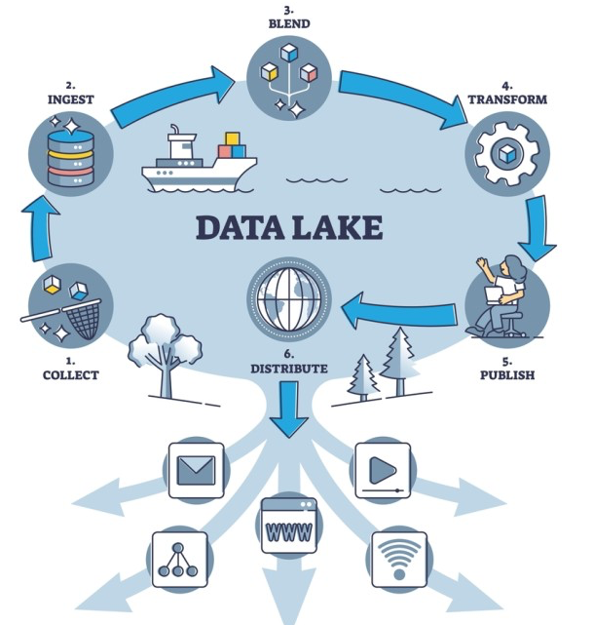
Module 2: Data Sourcing and Ingestion
Linear Programming – Transportation
The ‘data lake’ concept and its importance in a data-driven organisation
What is a Data Lake? Centralised storage repository
A data lake is a centralized repository that allows you to store all your structured and unstructured data at any scale.
You can store your data as-is, without having to first structure the data, and run different types of analytics—from dashboards and visualizations to big data processing, real-time analytics, and machine learning to guide better decisions.
Notes:
Today's businesses produce and consume data at an unprecedented rate.
The need for efficient, scalable, and flexible data storage and analytics solutions is more pressing than ever.
A data lake is a centralised storage repository that holds a vast amount of raw data in its native format until it is needed.
3. How Does a Data Lake Work?
Data Ingestion: Data is imported from diverse sources.
Data Storage: Stored in its native format (could be CSV, JSON, Parquet, images, etc.).
Data Processing: Use of analytics and machine learning tools directly on the data within the lake.
Data Retrieval: Extracted and structured on-demand.

Slide 22
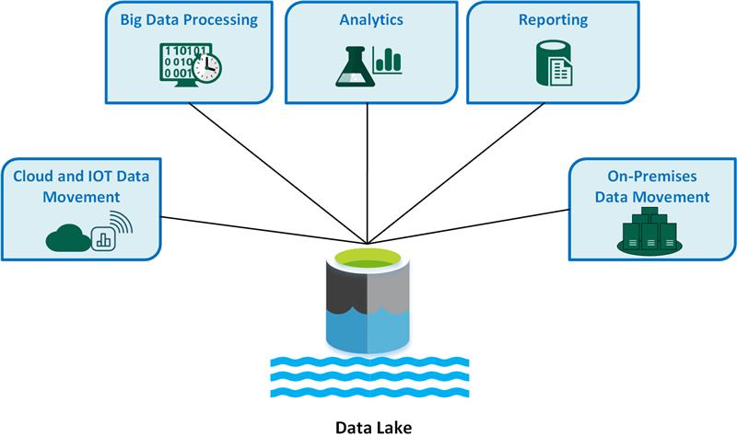
Module 2: Data Sourcing and Ingestion
Linear Programming – Transportation
The ‘data lake’ concept and its importance in a data-driven organisation
Data Lake Key Characteristics:
Stores structured, semi-structured, and unstructured data.
Uses a flat architecture where data is identified and tagged with unique identifiers.
Highly scalable.
Can store real-time data.

Slide 23
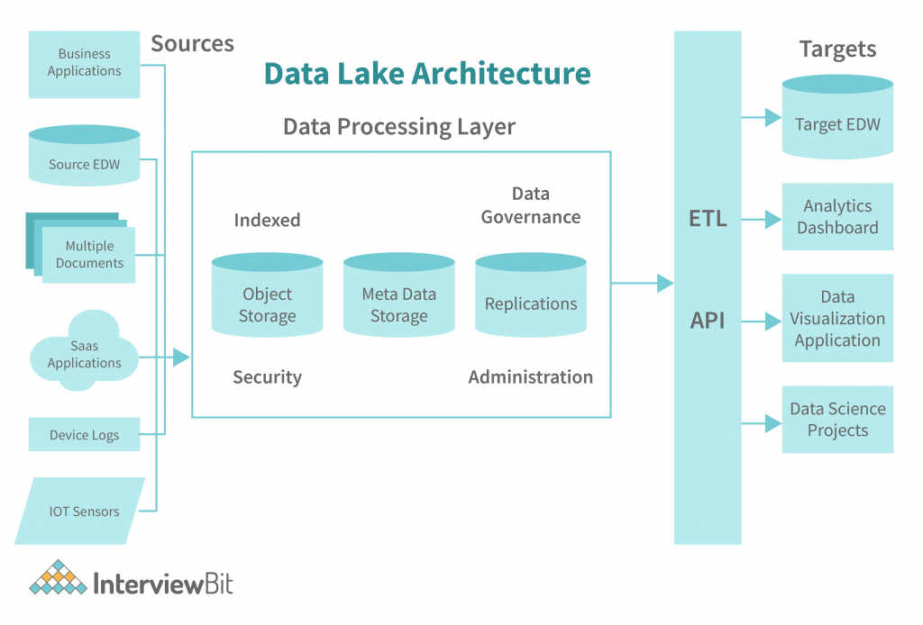
Module 2: Data Sourcing and Ingestion
Linear Programming – Transportation
The ‘data lake’ concept and its importance in a data-driven organisation
Importance of Data Lakes in a Data-Driven Organisation:
Single Version of Truth
Flexibility
Scalability
Advanced Analytics
Cost-Effective
Schema on read
Notes:
By functioning as a centralized data repository, data lakes provide a platform for data sharing and collaboration across different teams or departments within an organization.
This can promote data-driven decision-making across the organization.
Single Version of Truth: Central repository ensures data consistency.
Flexibility: Supports multiple data types, including real-time streams.
Scalability: Can easily grow with the business, adapting to increasing data loads.
Advanced Analytics: Facilitates complex analytical tasks, like machine learning, directly on the large datasets.
Cost-Effective: Often built on open-source technologies, allowing for cost-effective scaling.
Schema on Read: Unlike data warehouses (which use schema on write), data lakes apply the schema only when the data is read or queried. This allows storing raw data without upfront structuring, giving more flexibility for future analysis.

Slide 24
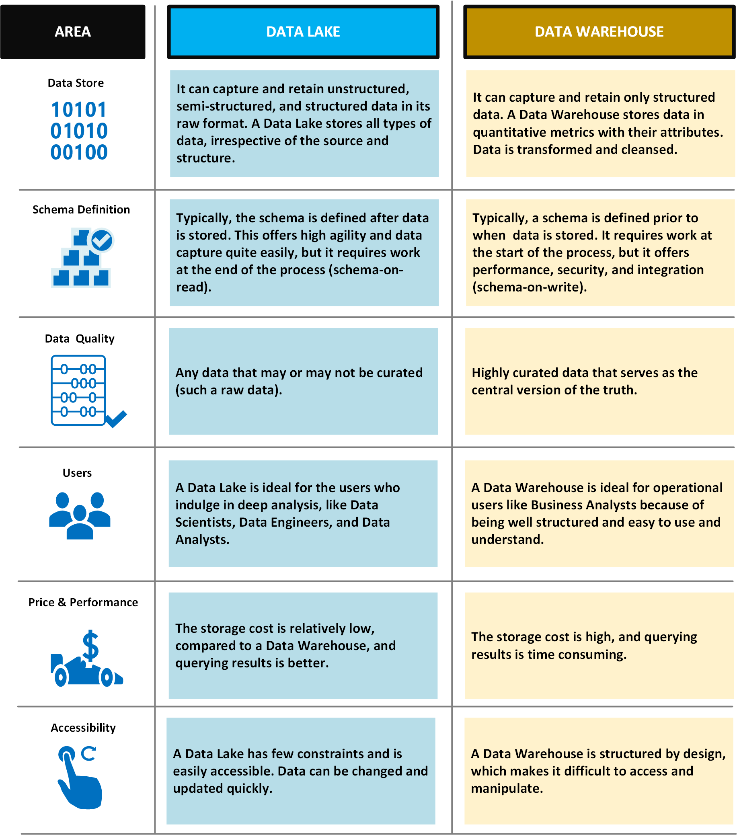
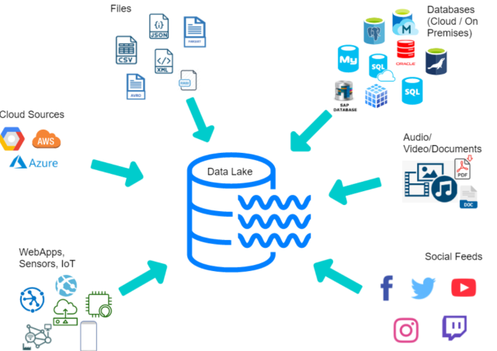
Module 2: Data Sourcing and Ingestion
Linear Programming – Transportation
Differences Between Data Lakes and Traditional Databases:

Slide 25
Module 2: Data Sourcing and Ingestion
Linear Programming – Transportation
Ready for a Quiz

Slide 26
Module 2: Data Sourcing and Ingestion
Linear Programming – Transportation
What is a data lake?
A) A storage repository that holds a vast amount of raw data in its native format.
B) A database designed for processing transactions.
C) A tool for data visualisation.
D) A method for data encryption.
Which of the following is a primary characteristic of a data lake?
A) Fixed schema on write.
B) Highly structured data.
C) Schema on read.
D) Limited data storage capacity.
Data lakes are ideal for:
A) Storing structured data only.
B) Performing high-speed transactions.
C) Storing both structured and unstructured data.
D) Immediate data cleansing and processing.
Which technology is most commonly used to manage data lakes?
A) Relational Database Management System (RDBMS).
B) Hadoop Distributed File System (HDFS).
C) Online Analytical Processing (OLAP).
D) Data Encryption Standard (DES).
What is a significant advantage of using a data lake?
A) Fixed storage capacity.
B) High cost of storage.
C) Flexibility in data analysis.
D) Limited data access.
6. Which of the following is a challenge associated with data lakes?
A) Data swamping.
B) Limited data storage.
C) Fast data retrieval.
D) High data quality.
7. Data lakes support which types of analytics?
A) Only real-time analytics.
B) Only batch processing.
C) Real-time, batch, and advanced analytics.
D) Only structured data analytics.
8. How do data lakes differ from data warehouses?
A) Data lakes are for structured data, data warehouses are for unstructured data.
B) Data lakes require a predefined schema, data warehouses do not.
C) Data lakes store raw data, while data warehouses store processed data.
D) Data lakes have limited storage, data warehouses have unlimited storage.
9. What is an essential factor to consider when implementing a data lake?
A) Ignoring data governance.
B) Ensuring data quality and governance.
C) Using a single data format.
D) Restricting data access to a few users.
10. Which statement best describes the scalability of data lakes?
A) Data lakes cannot handle large volumes of data.
B) Data lakes are scalable, handling more data without significant performance degradation.
C) Data lakes' performance decreases significantly as the amount of data increases.
D) Data lakes are only suitable for small-scale applications.
Notes:
1.A
2.C
3.C
4.B
5.C
6.A
7.c
8.C
9.B
10.B

Slide 27
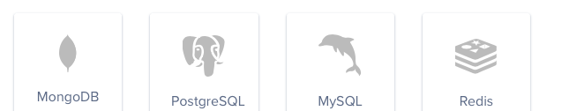



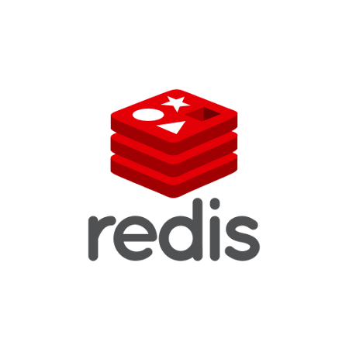

Module 2: Data Sourcing and Ingestion
Linear Programming – Transportation
Different Database Management Systems
Notes:
so we learn that the vastness of a data lake provides organizations with a deep reservoir of data from varied sources in its raw form.
Such an environment is indispensable for high-level analytics and machine learning operations.
However, when the need arises for real-time applications or when structured storage that supports quick, ad-hoc queries is desired, databases like MongoDB come into play.
1. MongoDB: Best Suited For: Semi-structured and Unstructured data.
Reason: MongoDB stores data in a flexible, JSON-like format. This allows it to adapt to varying attributes in the data without a fixed schema.
2. PostgreSQL: Best Suited For: Structured and Semi-structured data.
Reason: Primarily, PostgreSQL is a relational database (RDBMS) which means it works best with structured data in tables. However, with its JSON and JSONB data types, it also supports semi-structured data.
3. MySQL: Best Suited For: Structured data.
Reason: MySQL is an RDBMS, meaning it's optimized for data that fits well into tables with predefined columns (a fixed schema). It's less suited for varying or hierarchical data structures.
4. Redis: Best Suited For: Structured and Semi-structured data.
Reason: Redis is a key-value store, but it supports various data types, including strings, hashes, lists, and sets. While it can handle structured and semi-structured data, its primary strength is in rapid access and not necessarily data complexity.
5. Apache Cassandra is a distributed, NoSQL, wide-column store database designed for handling large volumes of data across many servers with high availability and no single point of failure.

Slide 28
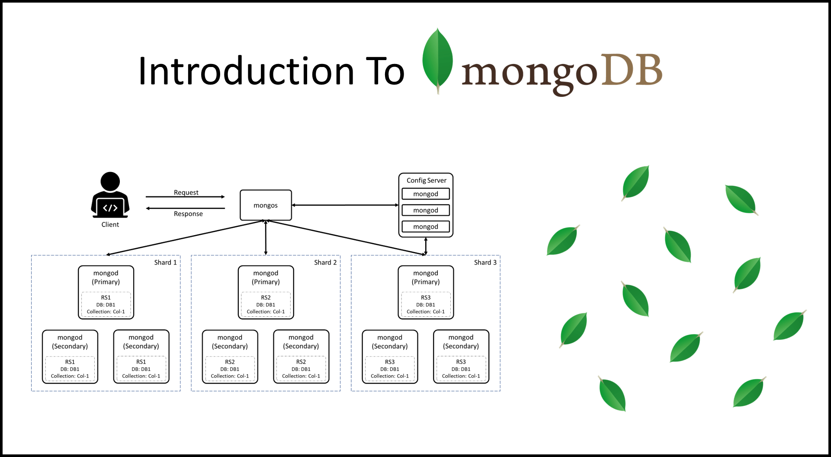
Module 2: Data Sourcing and Ingestion
Linear Programming – Transportation
Key Characteristics of MongoDB
Notes:
Key Features and Characteristics:
Document-Oriented Storage: Data is stored in documents, which are grouped in collections. Each document can have a unique structure with different fields, offering a lot of flexibility.
Dynamic Schema: Unlike relational databases where you need to define the schema beforehand, MongoDB allows you to create documents without defining the structure first, such as the number of fields or the types of their values.
Scalability: MongoDB is designed for horizontal scalability. This means as your data grows, MongoDB scales easily with sharding (distributing data across multiple servers).
High Performance: By using features like indexing, MongoDB can deliver high performance for read and write operations.
Aggregation Framework: MongoDB provides a powerful aggregation framework that allows you to process data and return computed results.
Rich Query Language: Even though it's a NoSQL database, MongoDB supports a rich set of query operations.
Support for Geospatial Data: It can store and process geospatial data and create geospatial indexes.

Slide 29
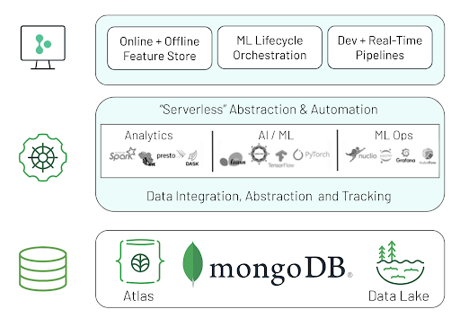
Linear Programming – Transportation
Module 2: Data Sourcing and Ingestion
Notes:
MongoDB is a widely recognized NoSQL database, whereas MongoDB Atlas is a service provided by MongoDB, Inc. The relation between the two is primarily that of a product (MongoDB) and its managed service variant (MongoDB Atlas).

Slide 30
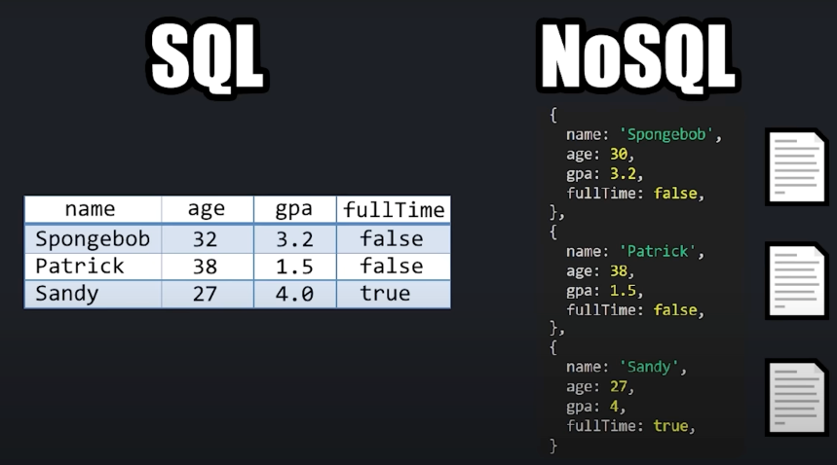
Linear Programming – Transportation
Module 2: Data Sourcing and Ingestion
Notes:
SQL databases are table-based, while NoSQL databases are document, key-value, graph, or wide-column stores.
SQL databases are better for multi-row transactions, while NoSQL is better for unstructured data like documents or JSON.

Slide 31
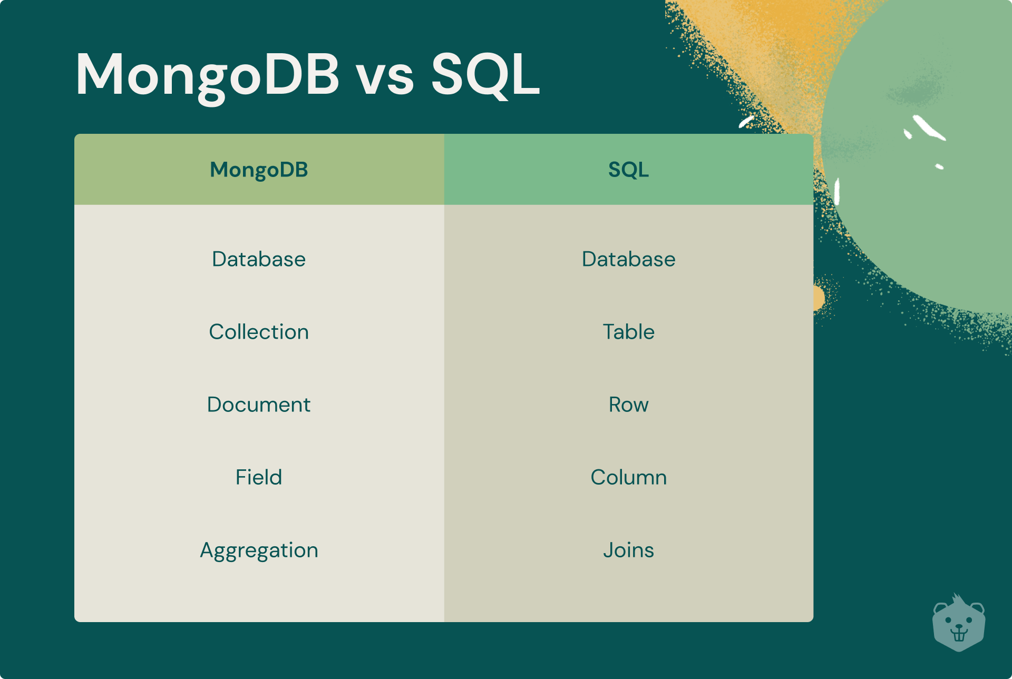
Module 2: Data Sourcing and Ingestion
Linear Programming – Transportation

Slide 32
Installation
Linear Programming – Transportation
15 mins break
Then we will be installing MongoDB and creating our first database and collection

Slide 33
Questions?

